Slide 1

Data Analysis – Examples and Explanation
Mian Muhammad Awais/Muhammad Hammad
NIAI – NAVTTC Training
Mainly Adopted From:
Data Analysis in Quantitative Research
Julia Duvall BA, Bowdoin College MPH Candidate, UNC Gillings School of Global Public Health

Slide 2
Learning Objectives
By the end of this presentation, participants will be able to:
Identify and differentiate types of statistical analysis
Understand when to apply descriptive and inferential statistics
Interpret common statistical outputs
Apply basic quantitative data analysis to both numerical (quantitative) and categorical (qualitative) data.

Slide 3
What is Qualitative Data Analysis?
Qualitative data analysis is the process of analyzing non-numerical and descriptive information
Supports further understanding of the “why” and “how” of global public health issues
Allows for heightened understanding of health behaviors
Lived experiences, barriers to care, and beliefs may be evaluated to assess their relation to health behaviors
Contributes to the improvement of public health programs and interventions

Slide 4
Example 1
At a health clinic, physicians notice that patients with high blood pressure are not taking their prescribed medications regularly. Numerical (quantitative) data shows the number of patients who are not regularly taking medications however it does not explain why. Collecting qualitative data through interviews and analyzing it may reveal that cost barriers or painful side effects are reasons why patients are not regularly taking medications.

Slide 5
What is Quantitative Data Analysis?
This presentation focuses on quantitative data analysis which is the process of analyzing numerical information to better understand relationships between variables.
Focuses on statistical analysis to better assess trends and patterns
Useful to better explain the “what” of global public health issues
Applies to both:
Categorical (qualitative) data – ex. gender, occupation, blood type
Numerical (quantitative) data – ex. age, blood pressure, heart rate
Most analyses are performed using statistical software (ex. R, STATA, SAS, and so forth).

Slide 6
Example 2
A researcher is interested in seeing if the high blood pressure medication (from example 1) is effective. Measuring systolic and diastolic blood pressure before treatment and after 6 months of treatment will allow for quantitative comparison and analysis to determine whether the medication works. ​

Slide 7
Types of Statistical Analysis
There are two main types of statistical analysis
Descriptive statistics
Summarizes and describes the main features of a dataset
Example: In a group of 100 patients, the average age is 60 years old and 70% of participants are women.
Inferential statistics
Allows for making predictions or generalizations about a population based on a given sample
Example: In a group of 100 patients, a researcher wants to know if exercising daily lowers blood pressure. Inferential statics will help determine if the result is applicable to a general population.

Slide 8
What are Descriptive Statistics?
Descriptive statistics are used to summarize and describe the characteristics of a dataset. There are four primary ways to describe the distribution of descriptive statistics.
Central Tendency
Describes the “center” of data
Mean, median and mode
Dispersion
Spread of values in the dataset
Range, variance, and standard deviation
Location
Indicates where a specific data point falls in the distribution
Quartile, decile, and percentile
Proportions and Rates
Summarizes how often something happens
Proportion, rate, prevalence, incidence, odds ratio (OR), and relative risk (RR)

Slide 9
Central Tendency
Measure​ | Definition​ | When to Use​ | Example​
Mean​ ​ ​ | The average value of the dataset​ | When data is normally distributed and there are no extreme outliers​ | Heart rate measurements from five participants are 60 bpm, 90bpm, 80bpm, 80bpm, and 110bpm. The mean is 84bpm.​
Mode​ | Most frequent value in a dataset​ | When evaluating categorical data (nominal)​ | Heart rate measurements from five participants are 60 bpm, 90bpm, 80bpm, 80bpm, and 110bpm. The mode is 80bpm​
Median​ | Midpoint (or middle) value in a dataset​. Data should be arranged in ascending order. If the number of values is odd, the median is the middle number. If even, it is the average of the two middle numbers. | When data is skewed or has outliers​ ​ | Heart rate measurements from five participants are 60 bpm, 80 bpm, 80 bpm, 90bpm, and 110bpm. The median is 80 bpm​
bpm indicates “beats per minute”, which is the heart rate

Slide 10
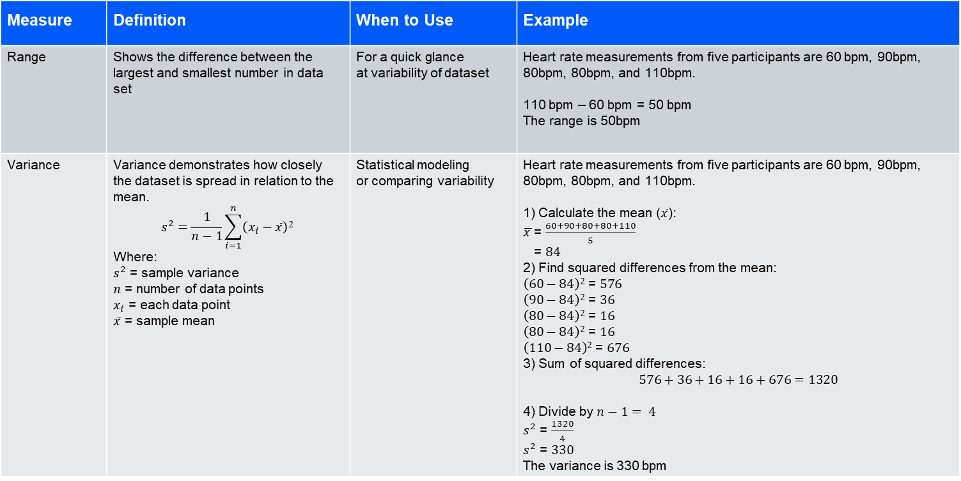
Dispersion
Measure​ | Definition​ | When to Use​ | Example​
Range​ | Shows the difference between the largest and smallest number in data set​ | For a quick glance at variability of dataset​ | Heart rate measurements from five participants are 60 bpm, 90bpm, 80bpm, 80bpm, and 110bpm. 110 bpm – 60 bpm = 50 bpm The range is 50bpm
Variance ​ ​ ​ | Variance demonstrates how closely the dataset is spread in relation to the mean.​ $$s^{2}=\frac{1}{n−1}\sum_{i=1}^{n}{\left(x_{i}−\overline{x}\right)2 }$$ Where: $s^{2}$ = sample variance $n$ = number of data points $x_{i}$ = each data point $\overline{x}$ = sample mean | Statistical modeling or comparing variability​ | Heart rate measurements from five participants are 60 bpm, 90bpm, 80bpm, 80bpm, and 110bpm. 1) Calculate the mean ($\overline{x}$): $\overline{x }$= $\frac{60+90+80+80+110}{5}$ = $84$ 2) Find squared differences from the mean: $\left(60−84\right)2$ = $576$ $\left(90−84\right)2$ = $36$ $\left(80−84\right)2$ = $16$ $\left(80−84\right)2$ = $16$ $\left(110−84\right)2$ = $676$ 3) Sum of squared differences: $$576+36+16+16+676=1320$$ 4) Divide by $n−1= 4$ $s^{2}$ = $\frac{1320}{4}$ $s^{2}$ = $330$ The variance is 330 bpm​

Slide 11
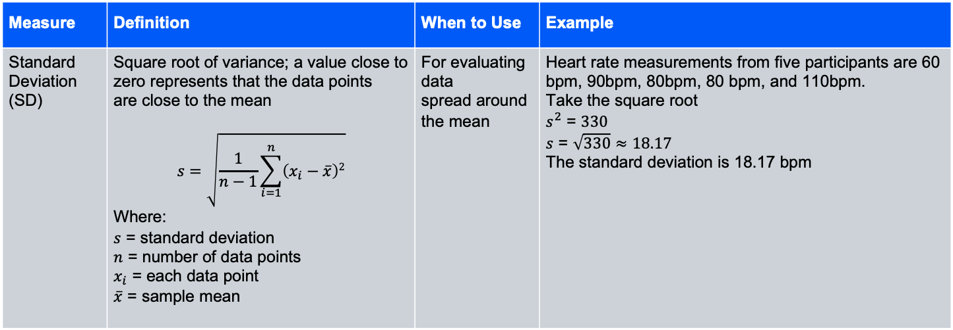
Dispersion Continued
Measure​ | Definition​ | When to Use​ | Example​
Standard Deviation (SD)​ ​ | Square root of variance; a value close to zero represents that the data points are close to the mean ​ $$s=\sqrt{\frac{1}{n−1}\sum_{i=1}^{n}{\left(x_{i}−\overline{x}\right)2}}$$ Where: $s$ = standard deviation $n$ = number of data points $x_{i}$ = each data point $\overline{x}$ = sample mean | For evaluating data spread around the mean ​ | Heart rate measurements from five participants are 60 bpm, 90bpm, 80bpm, 80 bpm, and 110bpm. Take the square root $s^{2}$ = $330$ $s$ = $\sqrt{330}≈18.17$ The standard deviation is 18.17 bpm​

Slide 12
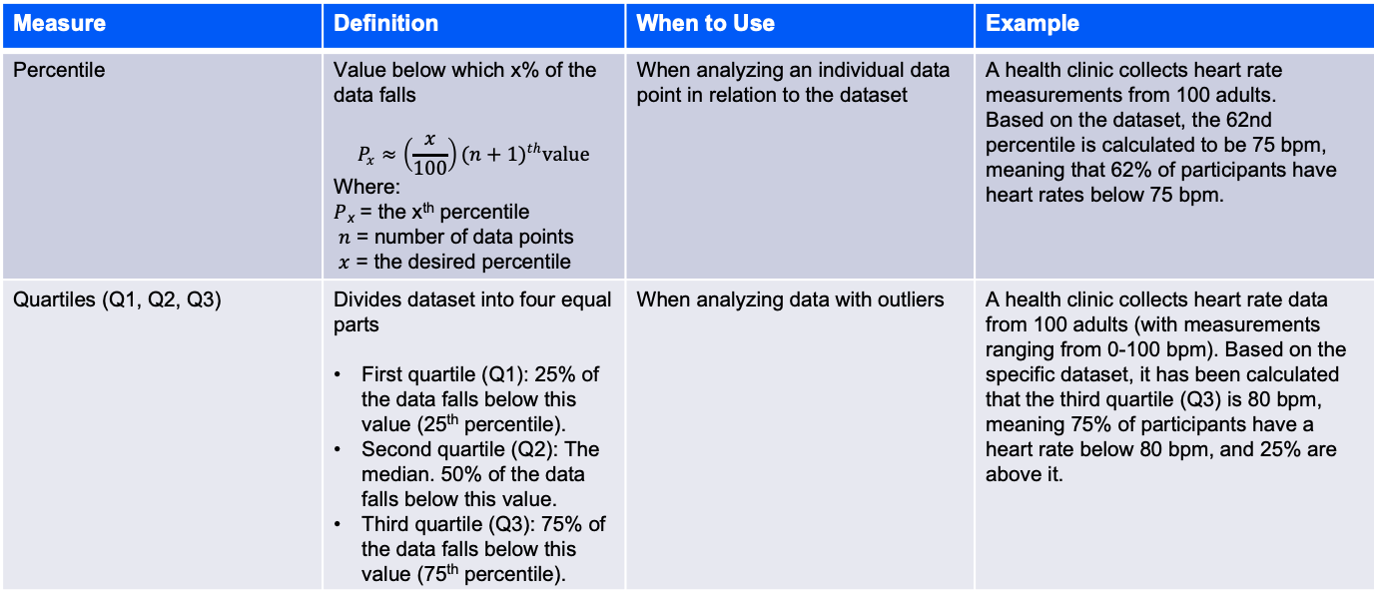
Location
Measure | Definition | When to Use | Example
Percentile | Value below which x% of the data falls $$P_{x}≈\left(\frac{x}{100}\right){(n+1)}^{th}value$$ Where: $P$_{x} = the x^{th} percentile $n$ = number of data points $x$ = the desired percentile | When analyzing an individual data point in relation to the dataset | A health clinic collects heart rate measurements from 100 adults. Based on the dataset, the 62nd percentile is calculated to be 75 bpm, meaning that 62% of participants have heart rates below 75 bpm.
Quartiles (Q1, Q2, Q3) | Divides dataset into four equal parts First quartile (Q1): 25% of the data falls below this value (25th percentile). Second quartile (Q2): The median. 50% of the data falls below this value. Third quartile (Q3): 75% of the data falls below this value (75th percentile). | When analyzing data with outliers | A health clinic collects heart rate data from 100 adults (with measurements ranging from 0-100 bpm). Based on the specific dataset, it has been calculated that the third quartile (Q3) is 80 bpm, meaning 75% of participants have a heart rate below 80 bpm, and 25% are above it.

Slide 13
Location
Measure | Definition | When to Use | Example
Deciles (D₁– D₁₀) | Divides data into ten parts First decile (D1): 10% of the data falls below this value. Second decile (D2): 20% of the data falls below this value. Third decile (D3): 30% of the data falls below this value. Fourth decile (D4): 40% of the data falls below this value. Fifth decile (D5): 50% of the data falls below this value. The median. Sixth decile (D6): 60% of the data falls below this value. Seventh decile (D7): 70% of the data falls below this value. Eighth decile (D8): 80% of the data falls below this value. Ninth decile (D9): 90% of the data falls below this value. | Similar to quartiles, but more beneficial for larger datasets | In the same dataset, it has been calculated that the ninth decile (D9) is 85 bpm, meaning 90% of participants have a heart rate below 85 bpm.

Slide 14
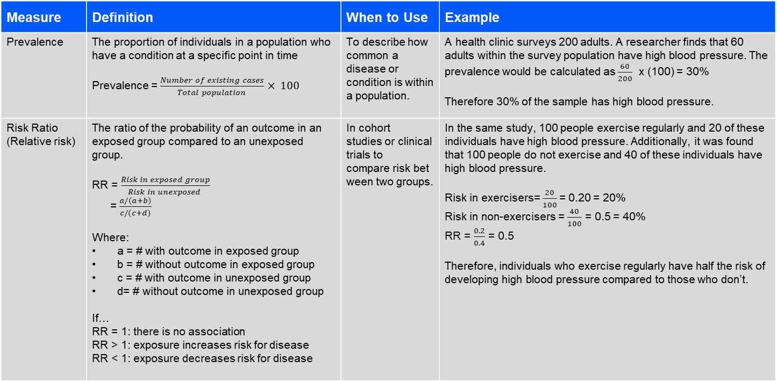
Proportions and rates
Measure​ | Definition​ | When to Use​ | Example​
Prevalence ​ | The proportion of individuals in a population who have a condition at a specific point in time Prevalence = $\frac{Number of existing cases}{Total population}$ $× 100$ | To describe how common a disease or condition is within a population. | A health clinic surveys 200 adults. A researcher finds that 60 adults within the survey population have high blood pressure. The prevalence would be calculated as $\frac{60}{200}$ x (100) = 30% Therefore 30% of the sample has high blood pressure.
Risk Ratio (Relative risk) | The ratio of the probability of an outcome in an exposed group compared to an unexposed group. RR = $\frac{Risk in exposed group}{Risk in unexposed }$ =$\frac{a/(a+b)}{c/(c+d)}$ Where: a = # with outcome in exposed group b = # without outcome in exposed group c = # with outcome in unexposed group d= # without outcome in unexposed group If… RR = 1: there is no association RR > 1: exposure increases risk for disease RR < 1: exposure decreases risk for disease | In cohort studies or clinical trials to compare risk between two groups. | In the same study, 100 people exercise regularly and 20 of these individuals have high blood pressure. Additionally, it was found that 100 people do not exercise and 40 of these individuals have high blood pressure. Risk in exercisers= $\frac{20}{100}$= 0.20 = 20% Risk in non-exercisers = $\frac{40}{100}$ = 0.5 = 40% RR = $\frac{0.2}{0.4}$ = 0.5 Therefore, individuals who exercise regularly have half the risk of developing high blood pressure compared to those who don’t.

Slide 15
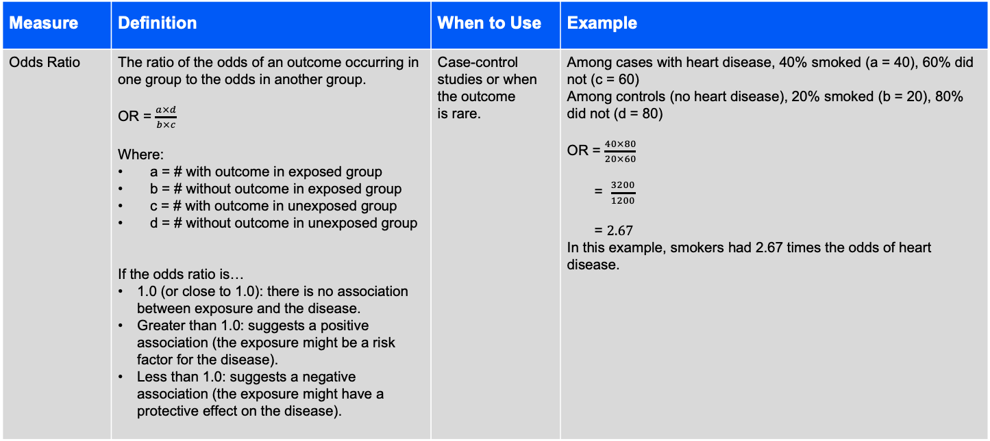
Proportions and rates
Measure​ | Definition​ | When to Use​ | Example​
Odds Ratio | The ratio of the odds of an outcome occurring in one group to the odds in another group. OR = $\frac{a×d}{b×c}$ Where: a = # with outcome in exposed group b = # without outcome in exposed group c = # with outcome in unexposed group d = # without outcome in unexposed group If the odds ratio is… 1.0 (or close to 1.0): there is no association between exposure and the disease. Greater than 1.0: suggests a positive association (the exposure might be a risk factor for the disease). Less than 1.0: suggests a negative association (the exposure might have a protective effect on the disease). | Case-control studies or when the outcome is rare. | Among cases with heart disease, 40% smoked (a = 40), 60% did not (c = 60) Among controls (no heart disease), 20% smoked (b = 20), 80% did not (d = 80) OR = $\frac{40×80}{20×60}$ = $\frac{3200}{1200}$ = $2.67$ In this example, smokers had 2.67 times the odds of heart disease.

Slide 16
Exploratory Data Analysis
Exploratory Data Analysis (EDA) is the process of examining and understanding a dataset before building models. It helps discover patterns, relationships, anomalies, and insights using statistics and visualizations.
The main goal is to:
Understand the structure of the dataset
Detect missing values and outliers
Identify relationships between variables
Generate insights for further analysis

Slide 17
Tools in Python
EDA is commonly performed using these Python libraries:
Pandas – data manipulation
NumPy – numerical computations
Matplotlib – basic visualization
Seaborn – advanced statistical plots
These libraries allow analysts to explore datasets efficiently.

Slide 18
Steps of EDA
1. Load necessary Python libraries before analysis.
Example:
import pandas as pd import numpy as np import matplotlib.pyplot as plt import seaborn as sns
2. Use pandas to read the dataset.
Example:
df = pd.read_csv("data.csv")

Slide 19
Steps …
Understand dataset structure using:
df.head() → first rows
df.shape → rows & columns
df.columns → feature names
df.info() → data types and missing values
df.describe() → statistical summary
These functions provide a quick overview of the dataset.

Slide 20
Steps …
EDA includes identifying and handling issues such as:
Missing values
Duplicate records
Incorrect data types
Outliers
Cleaning improves data quality before modeling.

Slide 21
Analysis Types
Univariate Analysis
Analyzing one variable at a time.
Common plots:
Histogram
Boxplot
Countplot
Purpose:
Understand distribution
Detect skewness
Identify outliers

Slide 22
Analysis Type
Bivariate Analysis
Analyzing relationships between two variables.
Common plots:
Scatter plots
Bar plots
Heatmaps
Purpose:
Detect correlations
Find patterns between features.

Slide 23
Analysis Types
Correlation Analysis
EDA also examines how variables relate to each other using correlation matrices.
Example:
df.corr() sns.heatmap(df.corr())
This helps identify features that strongly influence each other.

Slide 24
Analysis Types
Visualization in EDA
Visualization is important because it makes patterns easier to understand.
Common visualizations include:
Histograms
Scatter plots
Box plots
Heatmaps
Pair plots
These graphs help reveal trends and anomalies.

Slide 25
Why EDA is Important
EDA is essential because it:
Helps understand the dataset
Improves data quality
Detects anomalies early
Guides feature selection
Improves machine learning models
Without EDA, building models can lead to incorrect conclusions.

Slide 26
Demos
Follow the worksheets shared

Slide 27
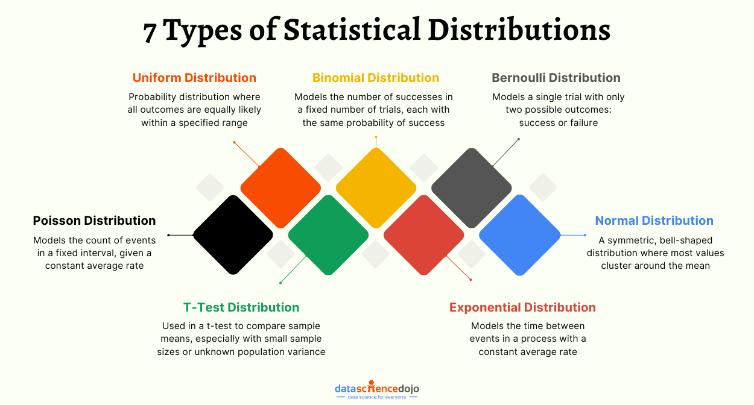
Distributions

Slide 28
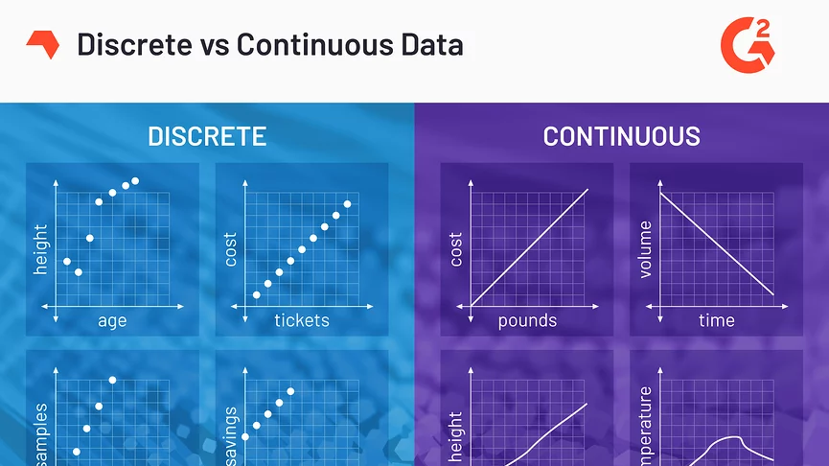

Slide 29
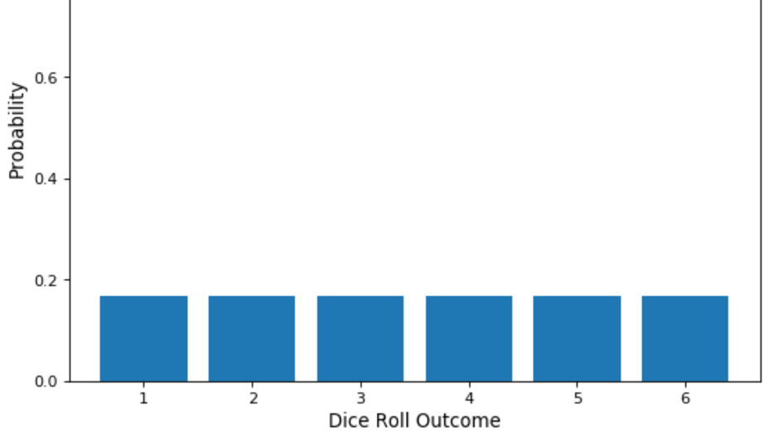
Uniform Distribution

Slide 30
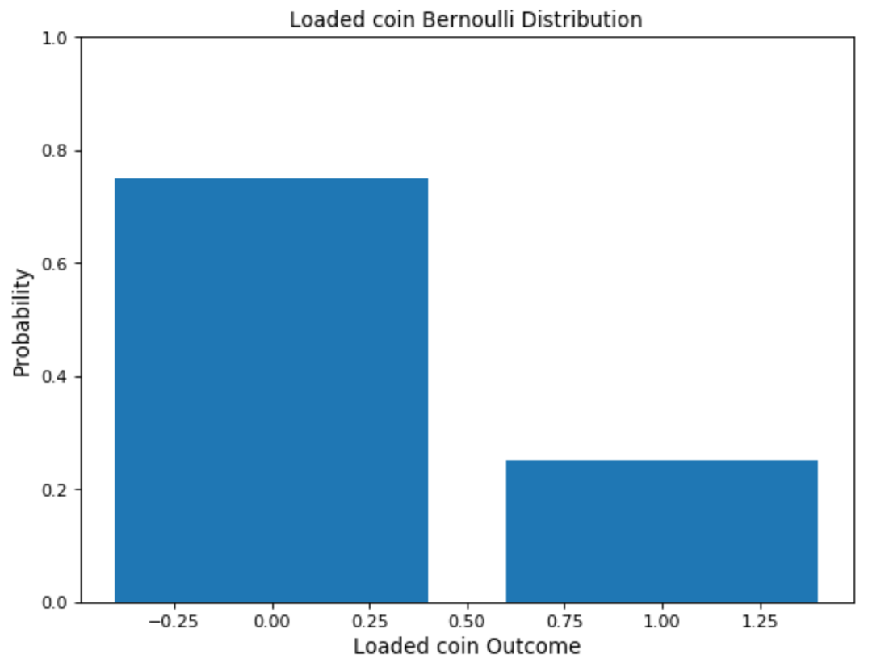

Slide 31
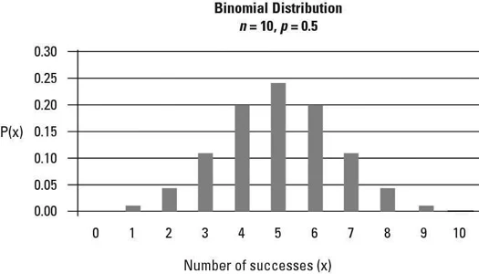

Slide 32
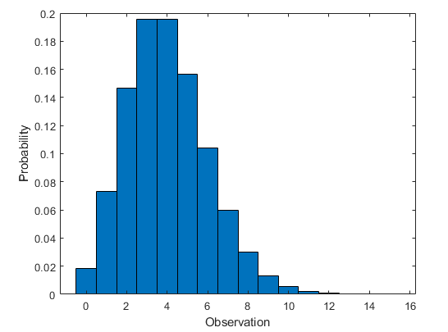
Poisson distribution
Poisson distribution deals with the frequency with which an event occurs within a specific interval.
Instead of the probability of an event, Poisson distribution requires knowing how often it happens in a particular period or distance.
For example, a cricket chirps two times in 7 seconds on average. We can use the Poisson distribution to determine the likelihood of it chirping five times in 15 seconds.
The events are independent of each other.
An event can occur any number of times (within the defined period).
Two events can’t take place simultaneously.

Slide 33
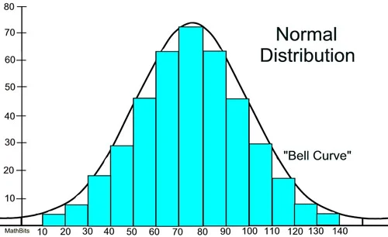
Normal Distribution - Continous
In a normal distribution graph, data is symmetrically distributed with no skew.
When plotted, the data follows a bell shape, with most values clustering around a central region and tapering off as they go further away from the center.

Slide 34
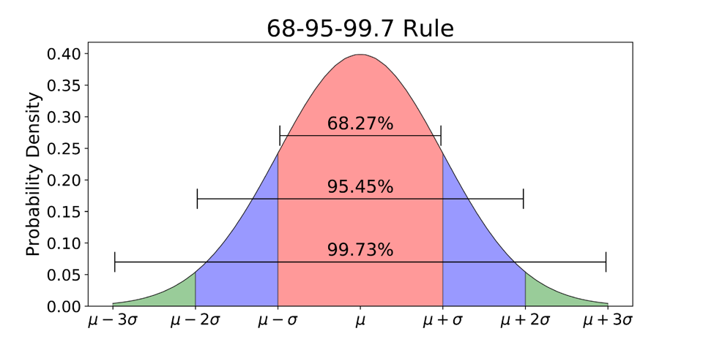
68% of all values lie within one standard deviation from the mean. In the example above, if the mean is 70 and the standard deviation is 10, 68% of the values will lie between 60 and 80.
Similarly, 95% of the values lie within two standard deviations from the mean.
99.7% lie within three standard deviations from the mean. This last interval captures almost all matters.
If a data point is not included, it is most likely an outlier.

Slide 35
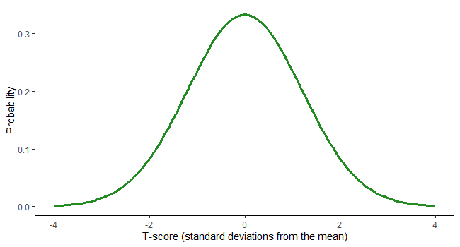
T- Distribution
The student’s t-distribution, also known as the t distribution, is a type of statistical distribution similar to the normal distribution with its bell shape but has heavier tails.
The t distribution is used instead of the normal distribution when you have small sample sizes.
For example,
suppose we deal with the total number of apples sold by a shopkeeper in a month. In that case, we will use the normal distribution.
Whereas, if we are dealing with the total amount of apples sold in a day, i.e., a smaller sample, we can use the t distribution.

Slide 36
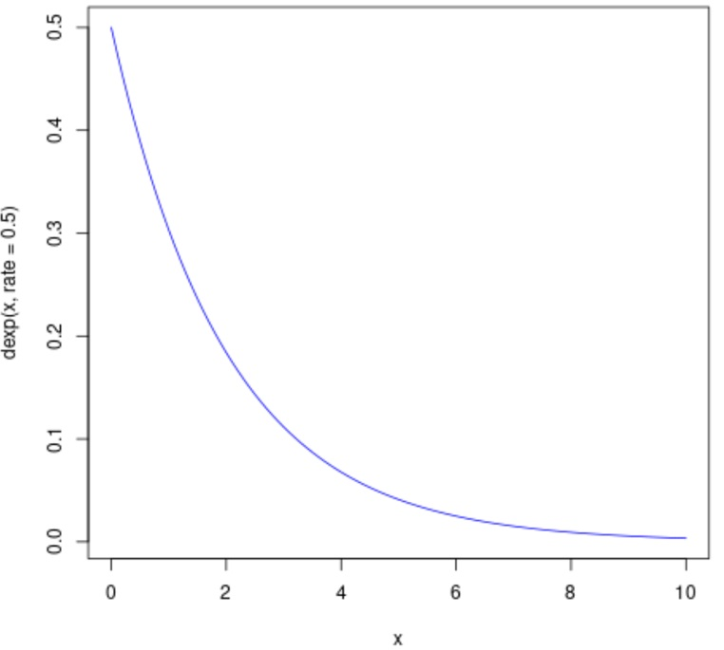
Exponential Distribution
Exponential distribution is one of the widely used continuous distributions. It is used to model the time taken between different events.
For example,
in physics, it is often used to measure radioactive decay;
in engineering, to measure the time associated with receiving a defective part on an assembly line; and
in finance, to measure the likelihood of the next default for a portfolio of financial assets.
Another common application of Exponential distributions in survival analysis (e.g., expected life of a device/machine).

Slide 37
What are Inferential Statistics?
Inferential statistics are used to make generalizations and conclusions from a dataset. There are two primary uses for inferential statistics.
Hypothesis Testing
Used to assess if there is enough evidence to reject the null hypothesis.
Estimation
Using sample data to estimate population parameters
The null hypothesis (H₀) is a statement that there is no effect or difference. It represents the assumption a researcher is trying to test against.

Slide 38
p-values
p-values demonstrate the probability that the observed results (or more extreme) could occur if the null hypothesis were true.
Thresholds (α) are set before analysis by the researcher to determine whether a result is statistically significant.
If p < α → reject the null hypothesis (statistically significant)
If p ≥ α → fail to reject the null (not statistically significant)
Commonly, α = 0.05, meaning that there is a 5% chance of finding a result as extreme as the one observed. However, α is not fixed it can be changed depending on:
Study design
Sample size
Potential consequences of a false positive

Slide 39
p-values
Example:
A researcher is studying whether a new heart medication lowers blood pressure compared to a placebo. After analyzing the data, they find:
p = 0.03
α = 0.05 (set by researcher)
Interpretation: Since p = 0.03 (which means p < 0.05), the result is statistically significant. This means there is only a 3% probability that the observed difference (or a more extreme one) occurred by chance if the medication had no true effect. The researcher rejects the null hypothesis (the new medication causes no difference) and concludes that the new medication likely lowers blood pressure.

Slide 40
Confidence Intervals
A confidence interval (CI) provides a range of values that likely contains the true population value (such as the true mean or proportion), based on the sample data.
Interpretation depends on the confidence level (commonly 95%):
A 95% CI means that if we repeated the study many times, 95% of the intervals would contain the true value.
99% CI is used when consequences of a wrong conclusion are high. It provides greater certainty, but the interval will be wider.
90% CI is used where a narrower range is acceptable and a quicker decision is needed.

Slide 41
Confidence Intervals
Example:
Guo and Zhang (2017) evaluated the association between ideal cardiovascular health (CVH) metrics and risk of cardiovascular events as well as mortality. When looking at smoking as an ideal CVH metric, they found that the risk ratio was RR = 0.54 (95% CI: 0.38-0.77) with p = 0.001 for cardiovascular mortality.
Interpretation: Ideal smoking status (non-smoking) is associated with a 46% lower risk of dying from cardiovascular causes. This is shown by a risk ratio (RR) of 0.54 with a 95% confidence interval from 0.38 to 0.77, meaning we are 95% confident that the true effect falls in this range.

Slide 42
Inferential Statistics (Numerical) – Pearson Correlation Coefficient
Pearson Correlation Coefficient: a statistical test that measures the strength and direction of a linear relationship between two continuous variables.
Pearson correlation coefficient is denoted by r
Ranges from -1 to +1
r = -1 → a perfect negative linear relationship
r = +1 → a perfect positive linear relationship
r = 0 → no linear relationship

Slide 43
Inferential Statistics (Numerical) – Pearson Correlation Coefficient
Example:
Reimers et al. (2018), studied whether regular exercise influences resting heart rate (RHR). They reported a correlation of r = -0.36 between baseline RHR and the change of RHR after participating in different types of sports.
This indicates that individuals with higher baseline RHR tend to show a decrease in RHR after participating in a sport.

Slide 44
Inferential Statistics (Numerical) – Student’s t-test
A Student’s t-test compares the means of two groups or of one group to determine if they are significantly different. Certain assumptions must be met to use a t-test (normality, independent observations, similar variances, and random sampling).
Types of t-tests:
1-sample t-test: comparing the mean of one group to a known value
2-sample t-test: evaluating two independent groups
2-sample paired t-test: using the same group at two different time points
Outputs from a t-test:
t-value: Size of the difference relative to variability in the sample data. A larger value indicates that there is a greater difference between groups.
Degrees of freedom (df): Number of independent variables that vary with respect to a given analysis. Affects the shape of t-distribution.
p-value: Shows the probability that the observed difference is due to chance (if p < 0.05)

Slide 45
Inferential Statistics (Numerical) – Student’s t-test
Example: Paired t-test
A researcher wants to know if a walking program reduces resting heart rate (RHR). 50 adults are measured before and after the program.
Before: mean RHR = 78 bpm
After: mean RHR = 72 bpm
Standard deviation of differences = 4 bpm
A paired t-test is conducted:
t = 7.07: The difference between the before and after RHR is large relative to the variability in the data.
df = 49: Degrees of freedom (50 participants – 1).
p < 0.001: There is less than a 0.1% chance that the result is due to random variation.
Since p < 0.05, the difference is statistically significant. Therefore, the walking program significantly reduced RHR.

Slide 46
Inferential Statistics (Numerical) – ANOVA
Analysis of Variance (ANOVA) evaluates the means of more than two groups to see if the mean across the groups is statistically significant
There are three primary types of ANOVA
1) One-way ANOVA: One independent variable being assessed
2) Two-way ANOVA: Two independent variables being assessed
3) Repeated Measures ANOVA: Same group measured multiple times
In ANOVA, independent variables are compared based on their effect on a dependent variable, which must be quantitative (numerical).

Slide 47
Inferential Statistics (Numerical) – ANOVA
ANOVA outputs:
degrees of freedom (df): Number of independent values in data that vary (see previous slides)
sum of squares (SS): Measures total variation in the data, showing how much variation exists between groups and within groups.
mean square (MS): The average variation, calculated by dividing SS by its respective df. There are two types of mean square (between groups and within groups)
F-statistic: Ratio of mean square between and mean square within. A large value indicates greater differences between group means compared to within-group variation.
p-value: see previous explanation: Indicates the probability that observed differences are due to chance (see previous slides).

Slide 48
Inferential Statistics (Numerical) – ANOVA
If ANOVA is significant (p-value < 0.05) it suggests that at least one group mean differs significantly from others. ANOVA does not show which groups differ thus a post-hoc test must be conducted.
Help identify which specific groups differ from each other
Controls for the risk of false positives that arise when making multiple comparisons.
Assumptions of ANOVA​
Observations are independent​ of each other
Normality
Dependent variable should be approximately normally distributed within each group
Homogeneity of variances
Variance across groups should be roughly equal

Slide 49
Inferential Statistics (Numerical) – ANOVA
Example: One-Way ANOVA
A researcher wants to know if different types of exercise affects resting heart rate (RHR). They divide 60 adults into 3 groups (20 adults per group):
Group 1: No exercise
Group 2: Walking program
Group 3: Running program
After 4 weeks, mean RHRs are:
Group 1: 78 bpm
Group 2: 72 bpm
Group 3: 68 bpm
ANOVA test results:
F = 8.24, df = (2, 57), p < 0.001
Interpretation: Since p < 0.05, at least one group differs significantly in mean RHR. A post-hoc test is needed to determine which exercise type(s) led to significantly lower RHR compared to others.

Slide 50
Inferential Statistics (Numerical) – Regression Analysis
A regression analysis predicts outcomes and examines how multiple independent variables relate to a dependent variable.
There are two types of regression analysis
1) Linear Regression: Continuous variables
2) Logistic Regression: Categorical variables
Outputs:
Coefficients (β): Represent estimated change in the dependent variable per unit change in a specific independent variable. They show direction and strength of the relationship.
p-value: Indicates if there is statistical significance (refer to prior slides)
Odds ratio (in logistic regression): Demonstrate how the odds of the outcome change with the independent variable

Slide 51
Inferential Statistics (Numerical) – Regression Analysis
Examples
Linear Regression: A study examined how hours of exercise per week predict resting heart rate. The coefficient (β) for exercise was –1.8 (p < 0.01). In short, for every additional hour of exercise, resting heart rate decreased by an average of 1.8 beats per minute. The p-value indicates this relationship is statistically significant.
Logistic Regression: In a regression model on heart disease, smokers had an odds ratio of 2.5 (p = 0.02). Smokers were 2.5 times more likely than non-smokers to develop heart disease.

Slide 52
Inferential Statistics (Categorical)– Chi-square test
A Chi-square test looks for statistically significant association between observed and expected frequencies among two categorical variables.
The larger the Chi-square (X²) value is, the more likely there is a significant difference between the observed and expected data
When X² is greater, the p-value will be lower
When X² is lower, the p-value will be greater
Outputs
Chi-square value (X²): Measures how much the observed data differs from what would be expected if there was no association between the variables. A larger X², indicates a greater difference between observed and expected counts.
degrees of freedom (df) = (number of rows – 1) × (number of columns – 1)
p-value: Indicates if there is statistical significance (refer to prior slides)

Slide 53
Inferential Statistics (Categorical)– Chi-square test
Example:
A researcher wants to know if there is an association between exercise habits (exercises regularly vs. does not exercise) and heart disease status (has heart disease vs. does not).
 | Heart Disease | No Heart Disease | Total
Exercises | 10 | 40 | 50
Does not exercise | 30 | 20 | 50
Total | 40 | 60 | 100
Chi-square test provides: X² = 6.63, df = 1, p = 0.01
Interpretation: Since p < 0.05, a conclusion can be made that exercise habits are significantly associated with heart disease status.

Slide 54
Selecting the Test of Best Fit
Test | Type of Data | When to Use
Pearson’s correlation coefficient | Two continuous variables | Correlation analysis
One-sample t-test | Continuous | When you have one group and are comparing it to an average
Independent t-test | Continuous | When you are comparing two separate groups
Paired t-test | Continuous | When you are measuring one group twice
One-way ANOVA | Continuous | When you are analyzing the means of more than two groups
Two-way ANOVA | Continuous | When you are analyzing the means of more than two groups and have two independent variables
Repeated Measures ANOVA | Continuous | When you are evaluating the same group at multiple time points
Linear regression | Continuous | Model relationships
Logistic regression | Binary | When you have binary/dichotomous variables
Chi-square test | Categorical | Comparing proportions

Slide 55
References
Aguinis, H., Vassar, M., & Wayant, C. (2019). On reporting and interpreting statistical significance and P values in medical research. BMJ Evidence-Based Medicine, 26(2), 39–42. https://doi.org/10.1136/bmjebm-2019-111264
Buderer, N. M., & Brannan, G. (2024, May 19). Comparing the means of independent groups: ANOVA, Ancova, MANOVA, and Mancova. StatPearls [Internet]. https://www.ncbi.nlm.nih.gov/sites/books/NBK606084/
The Chi squared tests. The BMJ. (2021, April 12). https://www.bmj.com/about-bmj/resources-readers/publications/statistics-square-one/8-chi-squared-tests
Faizi, N., & Alvi, Y. (2023). Correlation. Biostatistics Manual for Health Research, 109–126. https://doi.org/10.1016/b978-0-443-18550-2.00002-5
Government of Canada. (2021, September 2). Measures of Dispersion. Statistics Canada. https://www150.statcan.gc.ca/n1/edu/power-pouvoir/ch12/5214891-eng.htm
Green, J. L., Manski, S. E., Hansen, T. A., & Broatch, J. E. (2023). Descriptive statistics. International Encyclopedia of Education(Fourth Edition), 723–733. https://doi.org/10.1016/b978-0-12-818630-5.10083-1
Guo, L., & Zhang, S. (2017). Association between Ideal Cardiovascular Health Metrics and risk of cardiovascular events or mortality: A meta‐analysis of prospective studies. Clinical Cardiology, 40(12), 1339–1346. https://doi.org/10.1002/clc.22836
Holt, M. (2022). Statistical dispersion. EBSCO. https://www.ebsco.com/research-starters/science/statistical-dispersion
Kotronoulas, G., Miguel, S., Dowling, M., Fernández-Ortega, P., Colomer-Lahiguera, S., Bağçivan, G., Pape, E., Drury, A., Semple, C., Dieperink, K. B., & Papadopoulou, C. (2023). An overview of the fundamentals of data management, analysis, and Interpretation in Quantitative Research. Seminars in Oncology Nursing, 39(2), 151398. https://doi.org/10.1016/j.soncn.2023.151398

Slide 56
References
LibreTexts. (2020, August 11). Measures of location. Statistics LibreTexts. https://stats.libretexts.org/Courses/Las_Positas_College/Math_40%3A_Statistics_and_Probability/03%3A_Data_Description/3.03%3A_Measures_of_Position/3.3.01%3A_Measures_of_Location-_Deciles
Marshall, G., & Jonker, L. (2011). An introduction to inferential statistics: A review and practical guide. Radiography, 17(1). https://doi.org/10.1016/j.radi.2009.12.006
McDermid, R. (2021). Statistics in medicine. Anaesthesia & Intensive Care Medicine, 22(7), 454–462. https://doi.org/10.1016/j.mpaic.2021.05.009
McHugh, M. L. (2013). The chi-square test of Independence. Biochemia Medica, 143–149. https://doi.org/10.11613/bm.2013.018
Measures of central tendency. Australian Bureau of Statistics. (n.d.-a). https://www.abs.gov.au/statistics/understanding-statistics/statistical-terms-and-concepts/measures-central-tendency
Measures of shape. Australian Bureau of Statistics. (n.d.-b). https://www.abs.gov.au/statistics/understanding-statistics/statistical-terms-and-concepts/measures-shape
Mohr, D. L., Wilson, W. J., & Freund, R. J. (2022). Linear regression. Statistical Methods, 301–349. https://doi.org/10.1016/b978-0-12-823043-5.00007-2
National Institutes of Health. (n.d.). Finding and using health statistics. U.S. National Library of Medicine. https://www.nlm.nih.gov/oet/ed/stats/02-900.html
Reimers, A. K., Knapp, G., & Reimers, C.-D. (2018). Effects of exercise on the resting heart rate: A systematic review and meta-analysis of Interventional Studies. Journal of Clinical Medicine, 7(12), 503. https://doi.org/10.3390/jcm7120503

Slide 57
References
Runeson, P. (2016). Mere numbers aren’t enough. Perspectives on Data Science for Software Engineering, 303–307. https://doi.org/10.1016/b978-0-12-804206-9.00055-6
Salas-Parra, R. D., Castro-Ochoa, K. J., & Machado-Aranda, D. A. (2023). Basic science statistics. Translational Surgery, 195–199. https://doi.org/10.1016/b978-0-323-90300-4.00022-7
Shreffler, J., & Huecker, M. (2023, March 13). Hypothesis testing, P values, confidence intervals, and significance. StatPearls [Internet]. https://www.ncbi.nlm.nih.gov/books/NBK557421/
Smalheiser, N. R. (2017). ANOVA. Data Literacy, 149–155. https://doi.org/10.1016/b978-0-12-811306-6.00011-7
Tenny, S., Brannan, J., & Brannan, G. (2022, September 18). Qualitative study. StatPearls [Internet]. https://www.ncbi.nlm.nih.gov/books/NBK470395/
Wadhwa, R. R., & Azzam, D. (2023, July 17). Variance. StatPearls [Internet]. https://www.ncbi.nlm.nih.gov/books/NBK551689/
Wadhwa, R. R., & Marappa-Ganeshan, R. (2023, January 16). T test. StatPearls [Internet]. https://www.ncbi.nlm.nih.gov/books/NBK553048/
Wert, J. E., Neidt, C. O., & Ahmann, J. S. (1954). Quartiles, deciles, and percentiles. Statistical Methods in Educational and Psychological Research., 39–49. https://doi.org/10.1037/11779-003
World Health Organization. (2019). Using qualitative research to strengthen guideline development. World Health Organization. https://www.who.int/news/item/08-08-2019-using-qualitative-research-to-strengthen-guideline-development

Slide 58
Thank you!

